Slide 1
Supervised Machine Learning - Evolution of Tree-based Algorithms

Slide 2
Introduction of Kaggle Winning Solution
Evolution of Tree-based Algorithms
XGBoost
LightGBM
Catboost
Model Interpretability
Shap Value
Summarization

Slide 3
Kaggle Competition Selection Criteria
Select the competition from Jan 2018 – Present
Filter out those image analysis and audio analysis
Select those competition with award
Select those competition that last for a few months
Select those competition which has a detailed solution.

Slide 4
Summarization of Kaggle Competitions
Competition Name | Description | Prize | Date | 1st prize model | 2rd or 3nd prize
Mercari Price Suggestion Challenge | automatically suggest product prices to online sellers | $100,000 | 2018-02-22 | multilayer feedforward neural network with sparse inputs
Home Credit Default Risk | predict how capable each applicant is of repaying a loan | $70,000 | 2018-08-30 | NN, XGBoost, LightGBM and a Hill Climber linear model | LightGBM (CV: 0.808419) Random Forest (CV: 0.807978) Extra Trees (CV: 0.807539) Linear Regression (CV: 0.807291)
Santander Customer Transaction Prediction | identify who will make a transaction | $65,000 | 2019-04-11 | blend of these 2 models with weight 2.1 NN / 1 LGBM | NN: LGB 3:1
Jigsaw Unintended Bias in Toxicity Classification | (NLP)Detect toxicity across a diverse range of conversations | $65,000 | 2019-06-27 | BERT, XLNet and GPT2 | lstm + one bert/gpt
Google Cloud & NCAA® ML Competition 2018-Women's | Sports forecasting | $50000 | 2018-04-02 | single xgboost model
Elo Merchant Category Recommendation | (Regression)understand customer loyalty | $50000 | 2019-02-27 |  | Lightgbm + Nueral Netowork
Corporación Favorita Grocery Sales Forecasting | predict sales for a large grocery chain | $30,000 | 2018-01-16 | Ensemble of lgb and NN | CNN, LSTM and GRU
IEEE-CIS Fraud Detection | IEEE-CIS Fraud Detection | $20,000 | 2019-10-04 | 1.ensembled together with Konstantin's CatBoost and LGBMxgboos models 2. xgboost | lgb 0.9644 Catboost 0.9626 xgb/lgb blend 0.9623
Avito Demand Prediction Challenge | Predict demand for an online classified ad | $25,000 | 2018-06-28 | Ensemble NN | LightGBM NN
TalkingData AdTracking Fraud Detection Challenge | detect fraudulent click traffic for mobile app ads | $25,000 | 2018-05-08 | even bagged LGB models and a single bagged NN

Slide 5
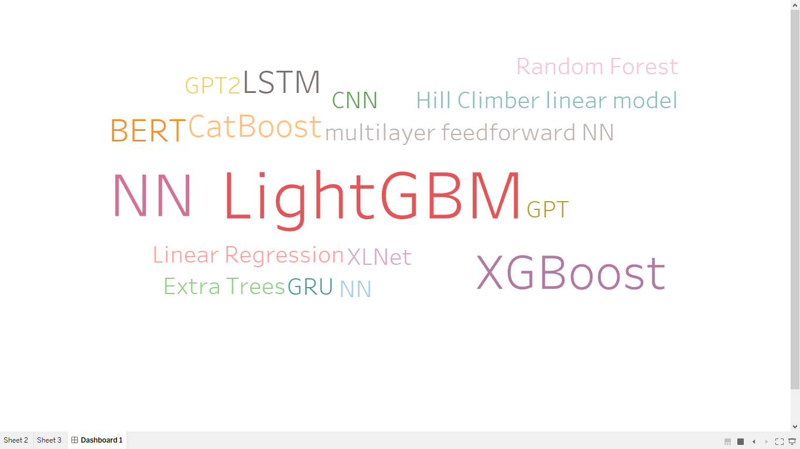
Word Cloud for Winning Models

Slide 6
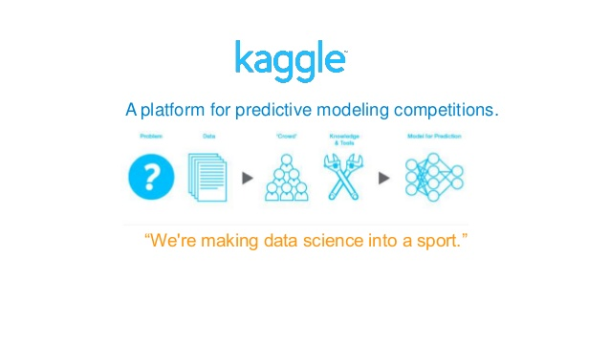
Some Findings of the Winning Models
Image and Audio analysis seems to have more and more competitions recent years.
Bert model has been applied to text analytics competition frequently.
Ensemble model is the trend and wins most of the competition.
For scenarios such as predicting the behavior of customer and fraud detection, LGBM model + Neural Network model.
Tree-based model become very popular recent years for tabular data.

Slide 7
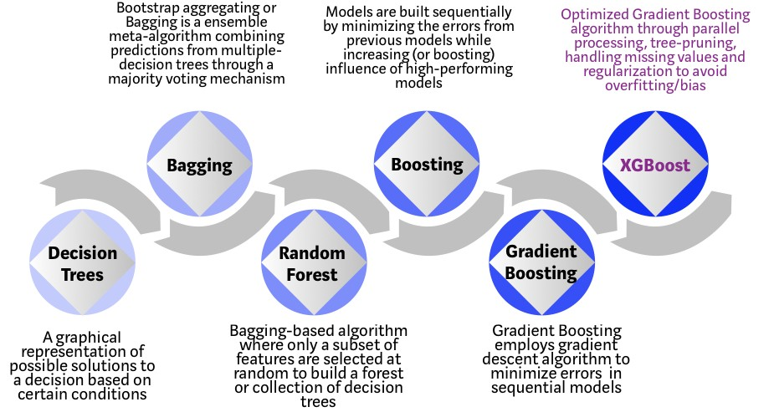
Evolution of Tree-based Algorithms Over Years

Slide 8
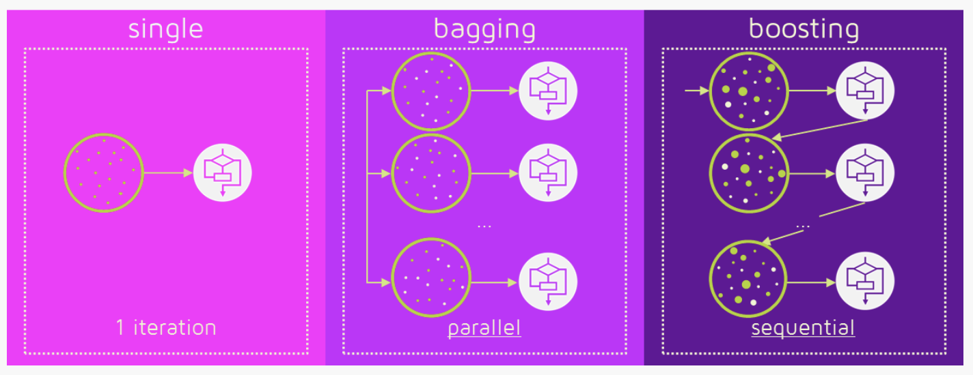
Evolution of Tree-based Algorithms Over Years

Slide 9
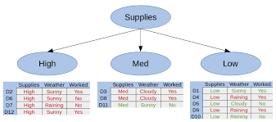
Decision Tree
Definition:
Decision trees are constructed via an algorithmic approach that identifies ways to split a data set based on different conditions.
Use Cases:
Price prediction
General business decision-making
Loan approval
Customer’s willingness to purchase a given product in a given setting
Advantage:
Easy to understand, explain and visualize
Can handle both numerical and categorical data, require less for the data preparation
Nonlinear relationships between parameters do not affect tree performance
Disadvantages:
Overfitting
Unstable to small variation
Not suitable for imbalance dataset

Slide 10
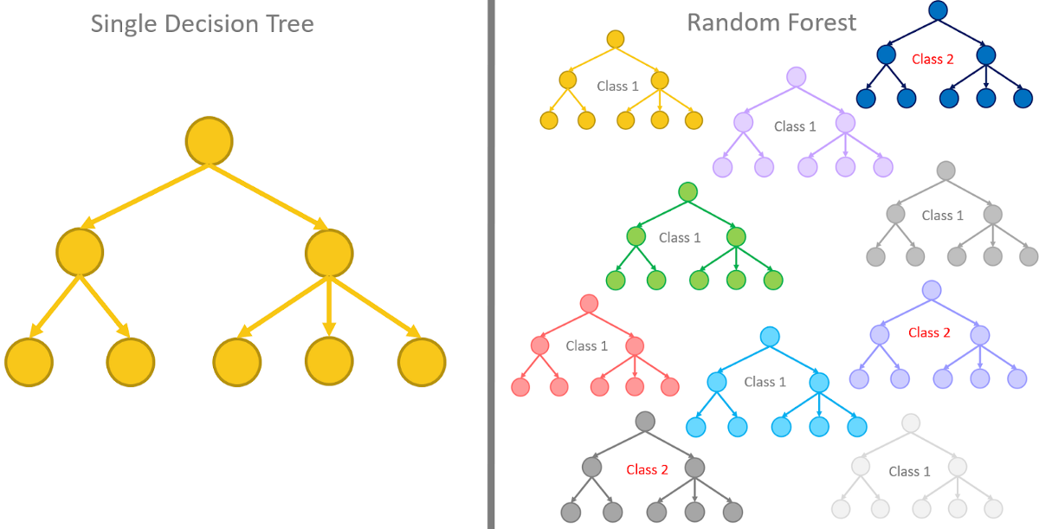
Random Forest
Definition:
The random forest is a classification algorithm consisting of many decisions trees. It uses bagging and feature randomness when building each individual tree to try to create an uncorrelated forest of trees whose prediction by committee is more accurate than that of any individual tree.
Use Cases:
Almost the same as decision tree
Advantage:
Can handle large datasets with higher dimension
Effective method when large portion of the data are missing
Can handle with imbalanced dataset
Not sensitive to outliers and no need for many data processing
Disadvantages:
It do a good job for classification but not good in regression job
It is like a black box method, need to try different parameters
Need to choose the number of trees

Slide 11
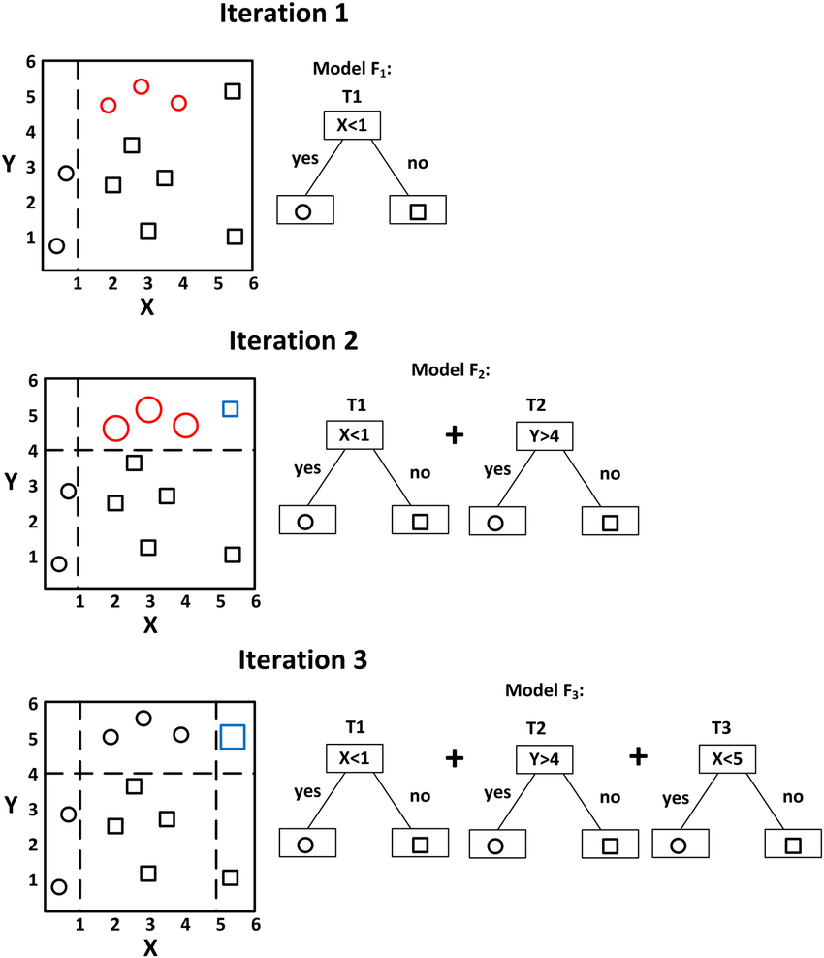
Gradient Boosting
Definition:
Gradient boosting is a machine learning technique for regression and classification problems, which produces a prediction model in the form of an ensemble of weak prediction models, typically decision trees. (Wikipedia definition)
Use Cases:
Almost the same as decision tree
Advantage:
High-performing
Disadvantages:
Hard to tune the model
Not speedy
Lack of interpretability

Slide 12
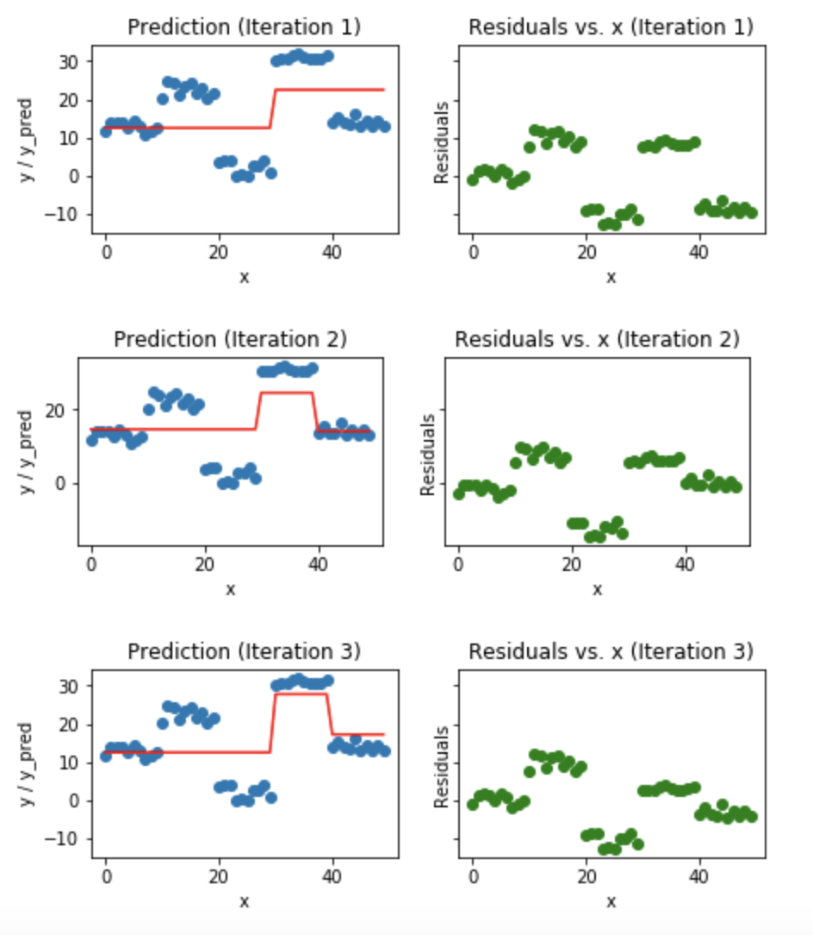
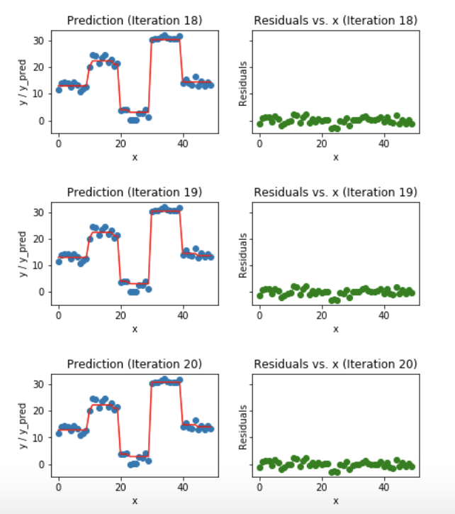
Gradient Boosting

Slide 13
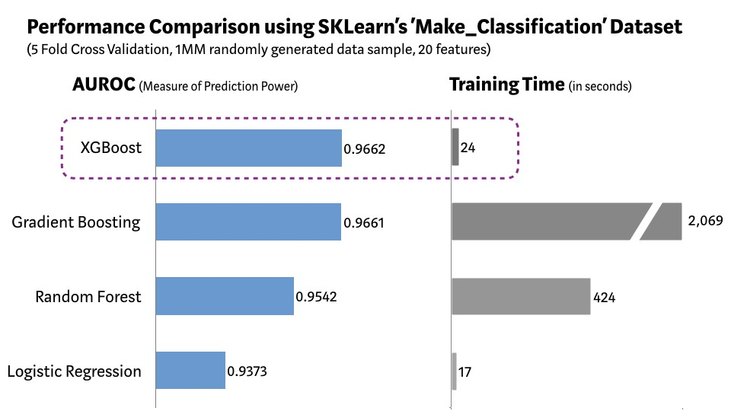
XGBoost
Definition:
XGBoost, though, actually refers to the engineering goal to push the limit of computations resources for boosted tree algorithms.
What makes XGBoost perform well?
System Optimization:
Parallelization
Tree Pruning
Hardware Optimization
Algorithm Optimization:
Regularization
Sparsity Awareness
Weighted Quantile Sketch
Cross-validation
Speed
Accuracy

Slide 14
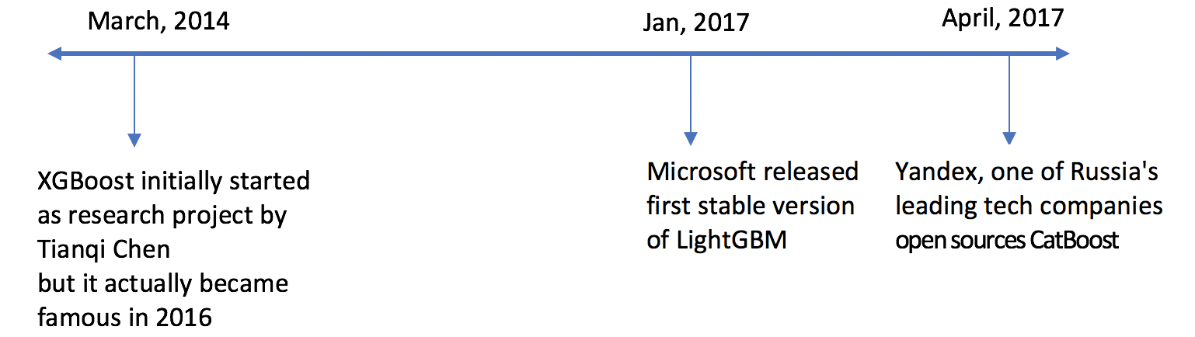
LightGBM
Definition:
Light GBM is a fast, distributed, high-performance gradient boosting framework based on decision tree algorithm, used for ranking, classification and many other machine learning tasks.
Advantage:
Faster training speed and higher efficiency
Lower Memory usage
Better accuracy than other boosting algorithm
Compatibility with large datasets
Disadvantages:
Hard to tune the model
Lack of interpretability

Slide 15
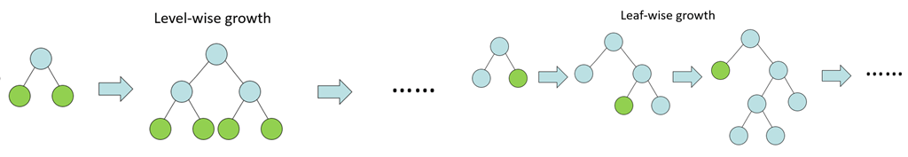
LightGBM
What makes LightGBM faster?
It splits the tree leaf wise with the best fit whereas other boosting algorithms split the tree depth wise or level wise rather than leaf-wise. So when growing on the same leaf in Light GBM, the leaf-wise algorithm can reduce more loss than the level-wise algorithm
GOSS (Gradient Based One Side Sampling) is a novel sampling method which down samples the instances on basis of gradients.

Slide 16

Catboost
CatBoost is a machine learning method based on Gradient boosting over decision trees.
Advantage:
Different boosting procedure to improve the efficiency
Handle categorical features
Give very good result before tuning
Disadvantages:
Can’t support sparse matrix
Takes more time to train than LightGBM if the dataset has many numerical features

Slide 17
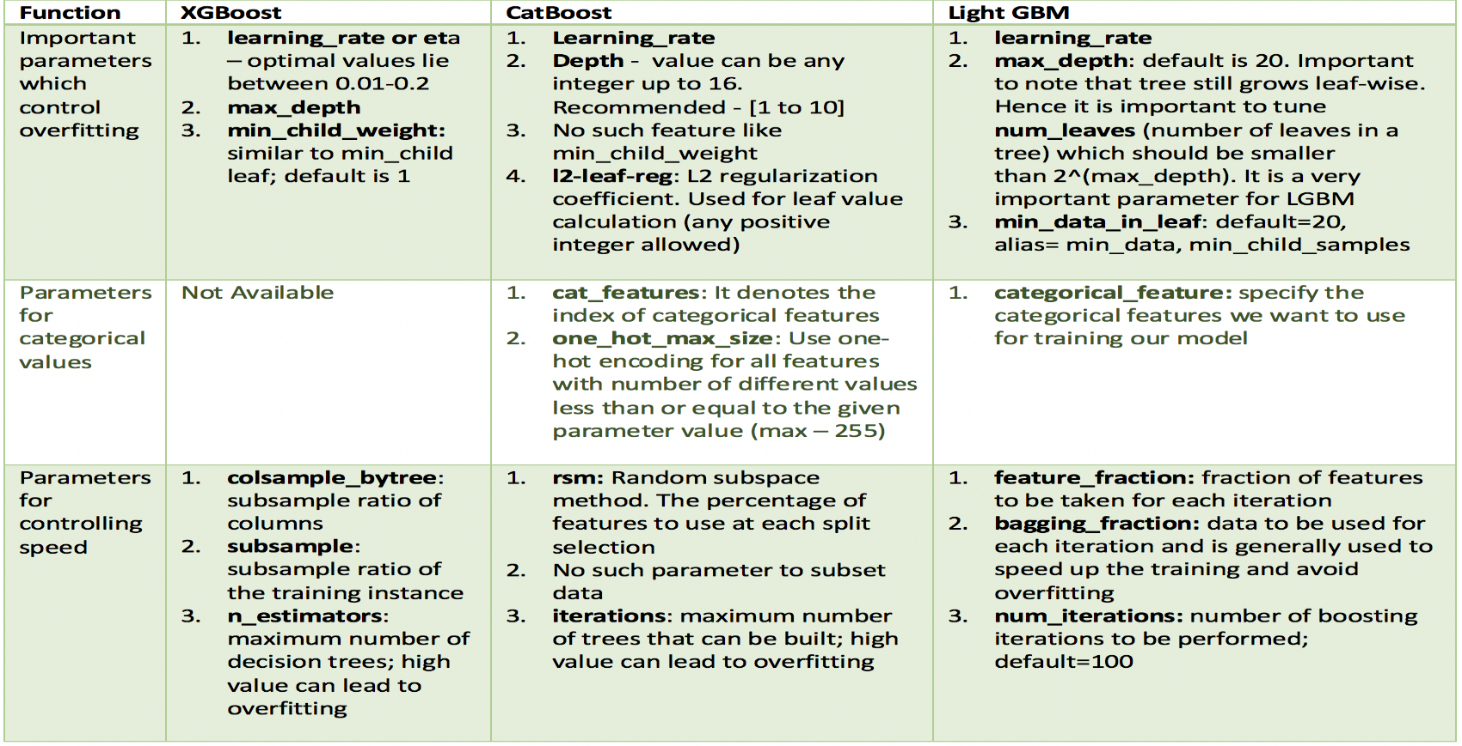
Parameters

Slide 18
Parameters
Parameter Tips:
Scale_pos_weight : Control the balance of positive and negative weights, useful for unbalanced classes. A typical value to consider: sum(negative instances) / sum(positive instances)
booster_type(boosting) : XGBoost (gbtree, gblinear and dart) ; LightGBM(gbdt, rf, dart, goss )
Dart : Dropouts meet Multiple Additive Regression Trees
Additional parameters for dart booster: XGBoost(one_drop, skip_drop, rate_drop…); LightGBM(drop_rate,max_drop,skip_drop…). Dart booster tuning is quite time consuming.

Slide 19
Package information
 | XGBoost | LightGBM | CatBoost
Publisher | Tianqi Chen | Microsoft | Yandex
License | Apache-2 | MIT | Apache-2
Release cycle | https://pypi.org/project/xgboost/0.90/#history | https://pypi.org/project/lightgbm/2.0.2/ | https://pypi.org/project/catboost/#history
Compatibility with Spark | XGBoost4J-Spark: https://xgboost.readthedocs.io/en/latest/jvm/index.html | Pyspark package: https://github.com/Azure/mmlspark/blob/master/docs/lightgbm.md | Not find yet

Slide 20
General Summarization
 | XGBoost | LightGBM | CatBoost
Support Numerical data | ✓ | ✓ | ✓
Support Categorical data | ✖ | ✖ | ✓
Support Multi-Class | ✓ | ✓ | ✓
Support Imbalance data | ✓ | ✓ | ✓
Handle Missing Value | ✓ | ✓ | ✓
Handle outliner | ✓ | ✓ | ✓
Training Time | ✓ | ✓✓ | ✖
Compatible with Spark | ✓ | ✓ | ✖

Slide 21
Thank you

